Slide 1
London’s puzzling employment gap
Why are women in London less likely to work when they are parents relative to UK peers?
Notes:
LPEG

Slide 2
There has been no trend in employment rates in London

Slide 3
Employment gaps: parents are more likely to be in work…
Notes:
Overall, parental employment rates are above non-parents for almost all groups (notably not women). This is probably due to age composition, with working age people more likely to be parents.

Slide 4
… because parents are far more likely to be working-age than not
Notes:
The shares are pretty much for the UK overall too – i.e. that the prop of parents who are 18-64 is ~100% while it is 95% for non-parents

Slide 5
Female parents in London have lower employment rates than UK average

Slide 6
… and it has persisted for some time

Slide 7
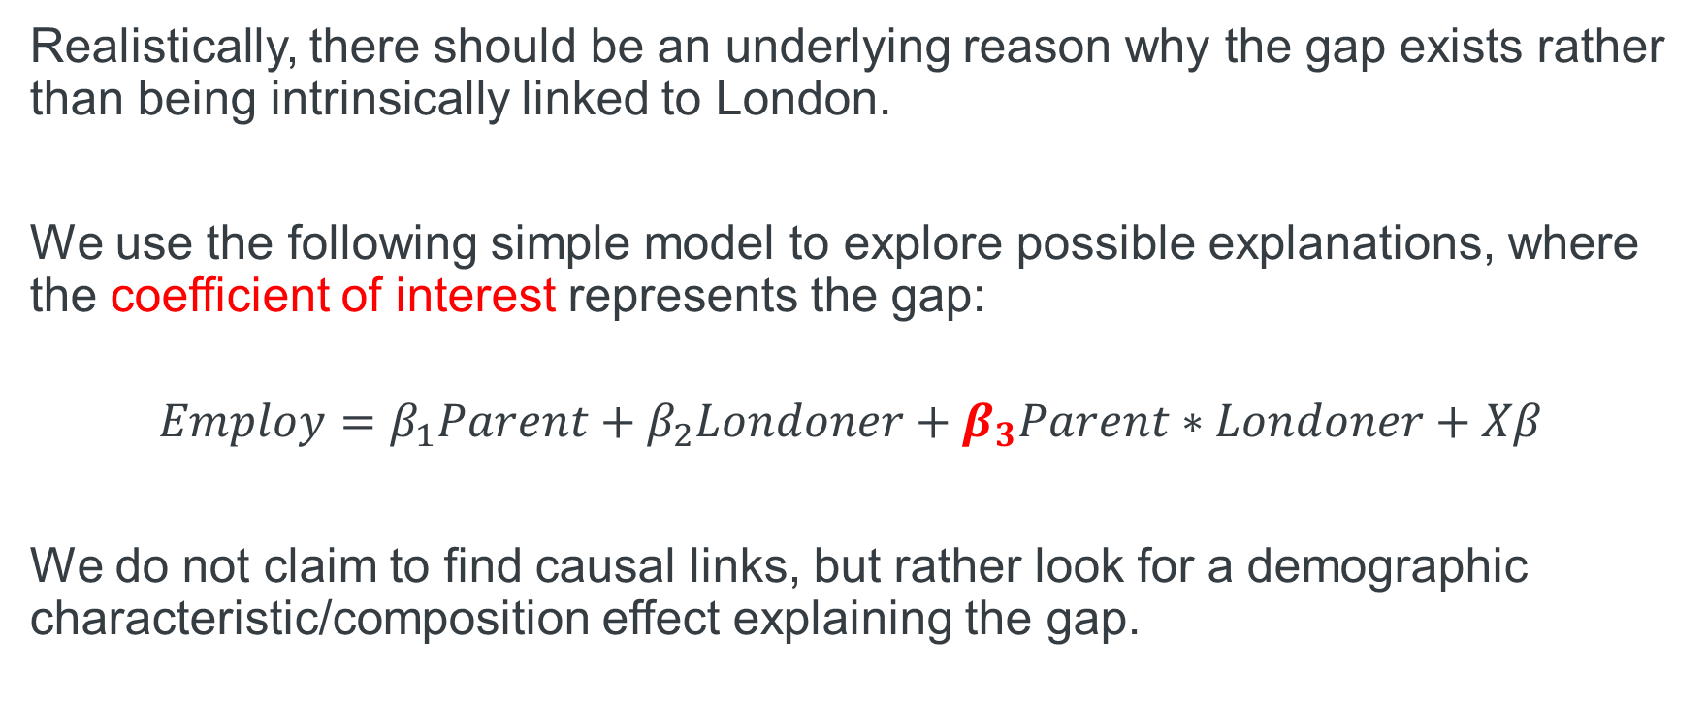
Regressions to find underlying reasons
Realistically, there should be an underlying reason why the gap exists rather than being intrinsically linked to London.
We use the following simple model to explore possible explanations, where the coefficient of interest represents the gap:
$$Employ=β_{1}Parent+β_{2}Londoner+β_{3}Parent∗Londoner+Xβ$$
We do not claim to find causal links, but rather look for a demographic characteristic/composition effect explaining the gap.
Note: regression run on sample of women only.

Slide 8
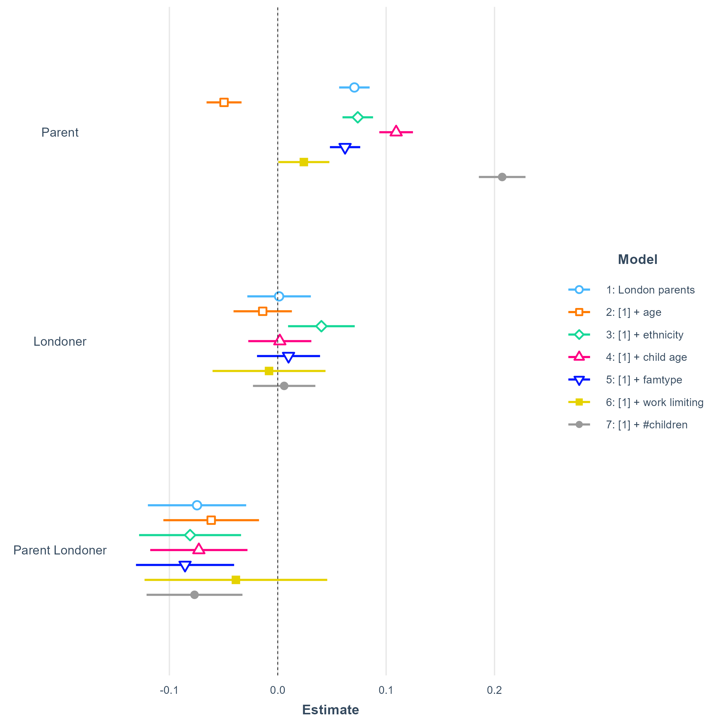
The gap remains stubborn when disentangling characteristics
We regress employment on personal and family characteristics for women
Each model introduces a single additional covariate
Point estimates and 95% CI shown in chart for coefficient of interest
The gap remains in all models except when including work-limiting health issues
Note: other covariate coefficients not shown.
Notes:
Base case: non-parent, non-London, male, white, age 25-34, youngest child aged <2yrs, single, no work-limiting health, no children

Slide 9
Appendix

Slide 10
Yet, London has same share of working-age mothers as UK average
Notes:
London has more mothers in 35-49 age range, and since London has a lot of students, there is a lower share of 25-34 aged ones. So age does not explain this one

